Slide 1

MECHANICAL VIBRATION
ANALYSIS OF TUNED MASS DAMPER
hARSHA VARDHAN PANDRANKI 234103419
PANKAJ KAUSHIK 234103426
SOURABH SAINI 234103438

Slide 2
content
Introduction
System analysis
Application
Example
Literature review
Derivation of EOM
MATLAB code
Conclusion

Slide 3
dynamic vibration absorber
It is a mechanical device used to reduce or eliminate vibration of primary structure.
A small mass that is connected to a system by a spring and a damping element without any other support, in order to reduce vibration of the system is called Tuned MASS and system is called TUNED MASS DAMPER(TMD).
Dynamic absorbers and tuned mass dampers are the realizations of tuned absorbers and tuned dampers for structural vibration control applications.

Slide 4
Vibration control
Active control
It is usually composed of monitoring, diagnosis and execution elements, and is well-adapted to the variations of machining process. Despite the success in attenuating the machine vibrations, active control exhibits the disadvantages of high cost and complicated implementation.
Passive control
It is effective in the vibration control and easy to implement. The tuned mass damper (TMD) is one kind of widely used passive control devices in the machining.

Slide 5
applications
Tall and slender free-standing structures (bridges, pylons of bridges, chimneys, TV towers) which tend to be excited dangerously in one of their mode shapes by wind.
Stairs, spectator stands, pedestrian bridges excited by marching or jumping people. These vibrations are usually not dangerous for the structure itself, but may become very unpleasant for the people.
Steel structures like factory floors excited in one of their natural frequencies by machines , such as screens, centrifuges, fans etc.

Slide 6
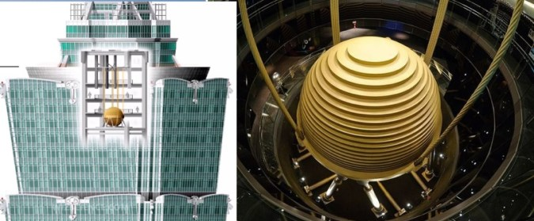

Slide 7
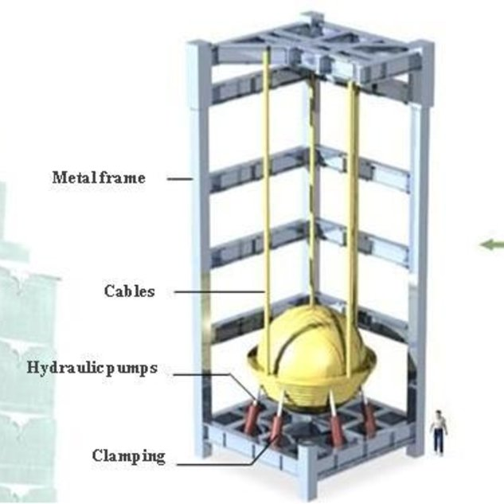
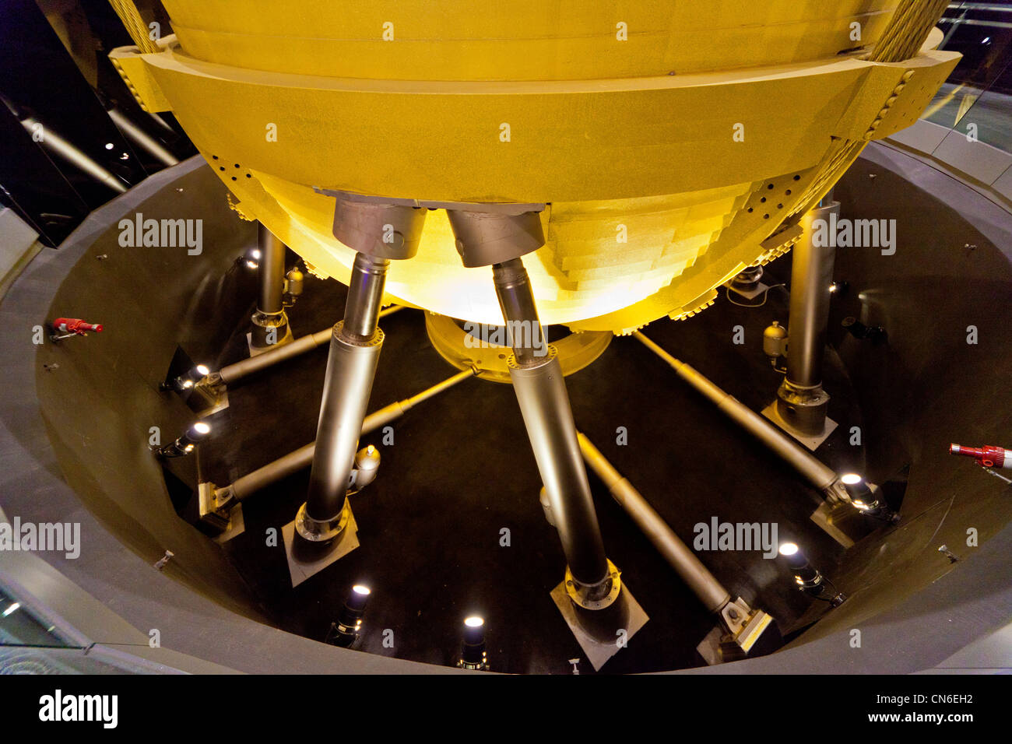

Slide 8
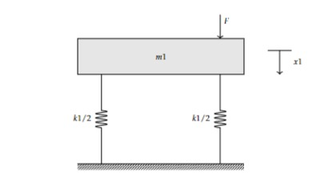
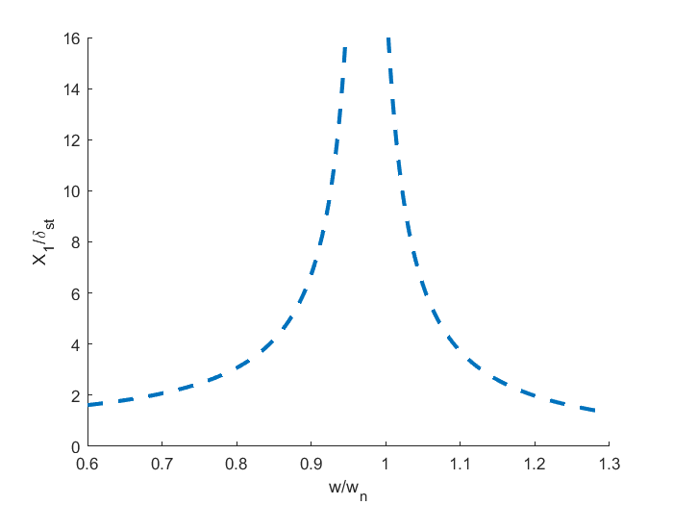
Without tmd

Slide 9
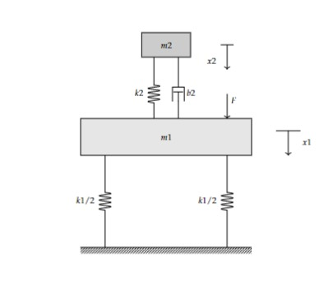
1 dof tmd (m₂/m₁=0.05)

Slide 10
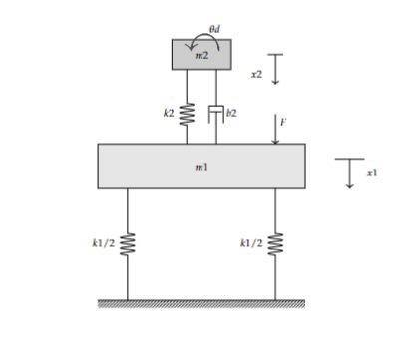
2 dof tmd (m₂/m₁=0.05)

Slide 11
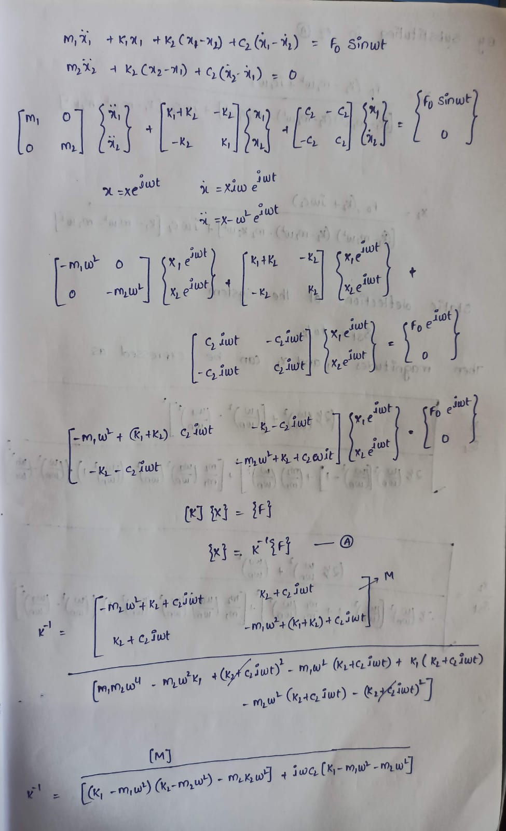
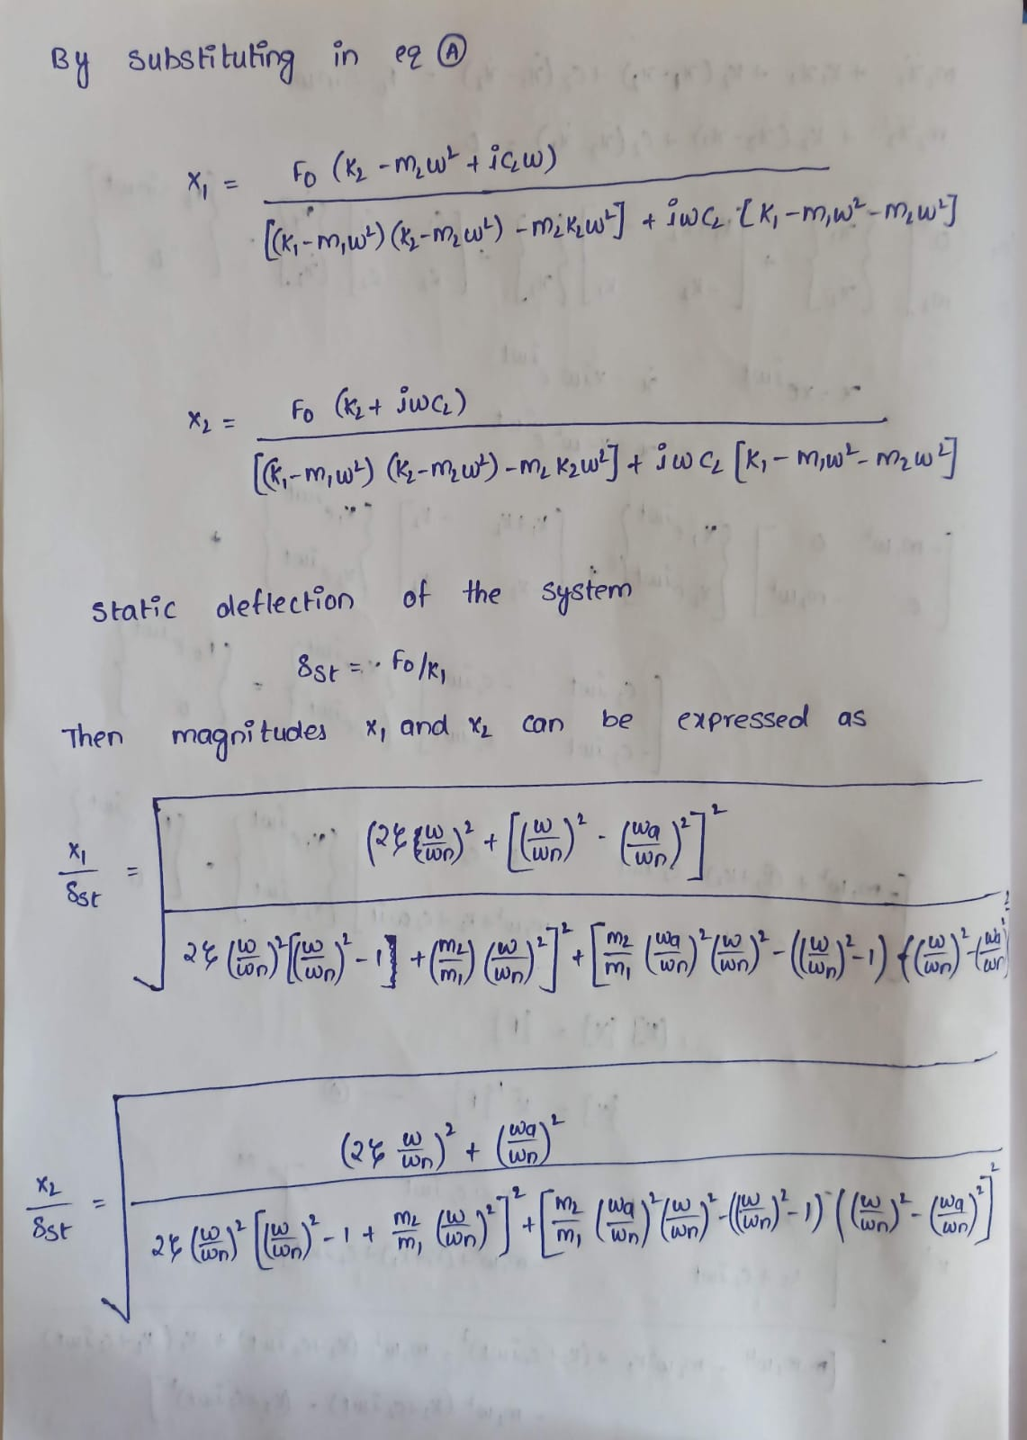

Slide 12
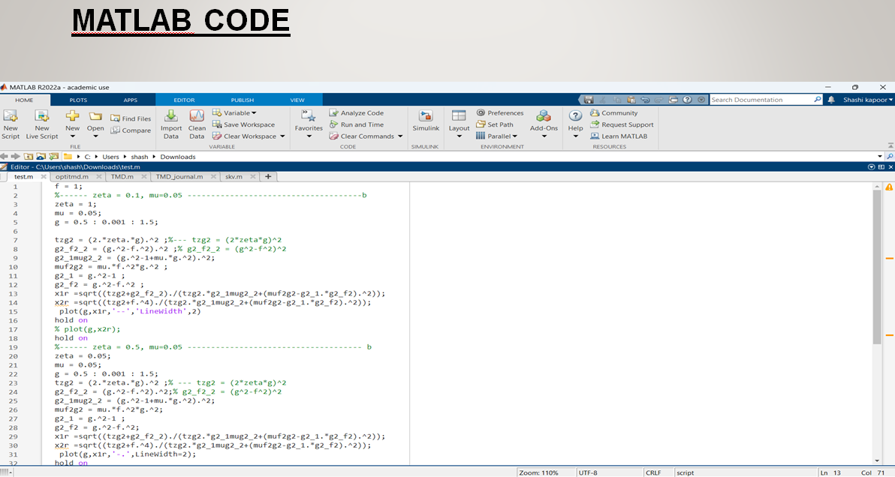

Slide 13
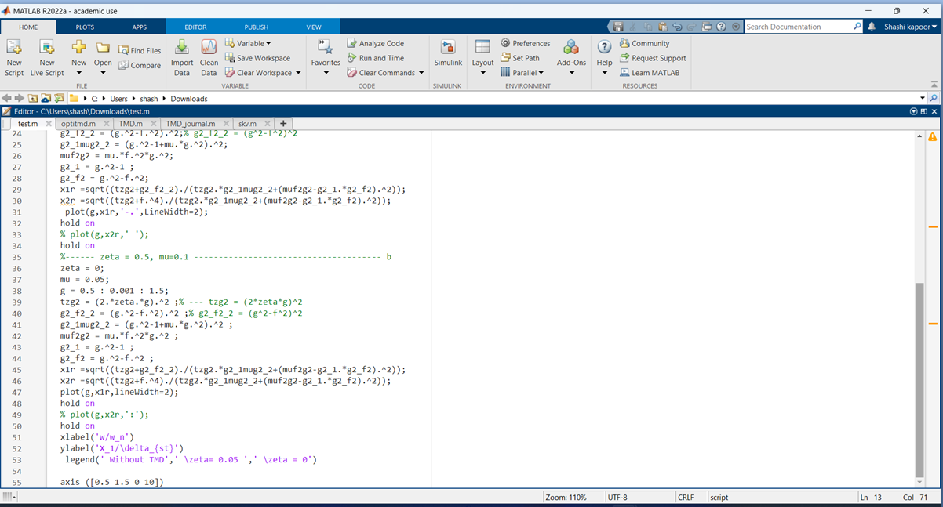

Slide 14
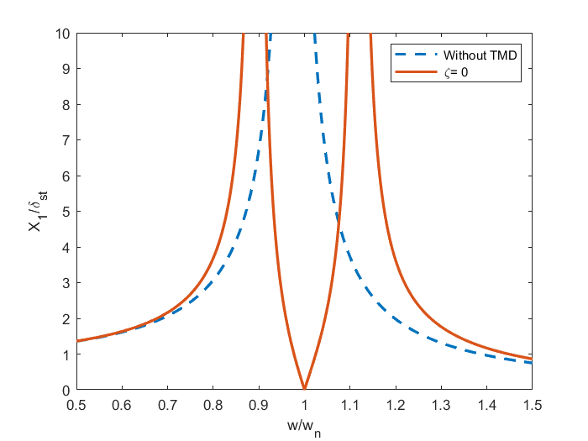
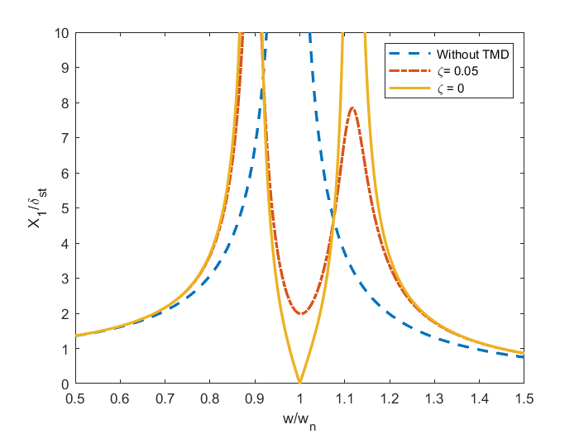
Without damping
With damping

Slide 15
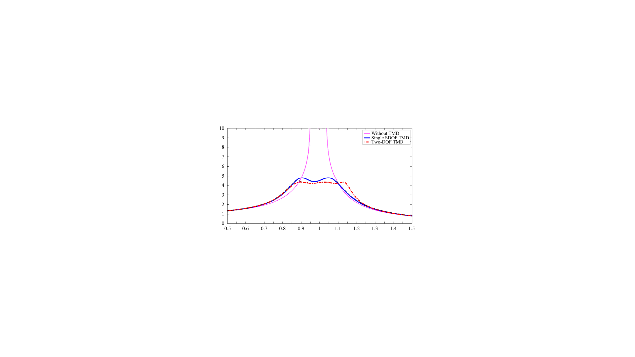
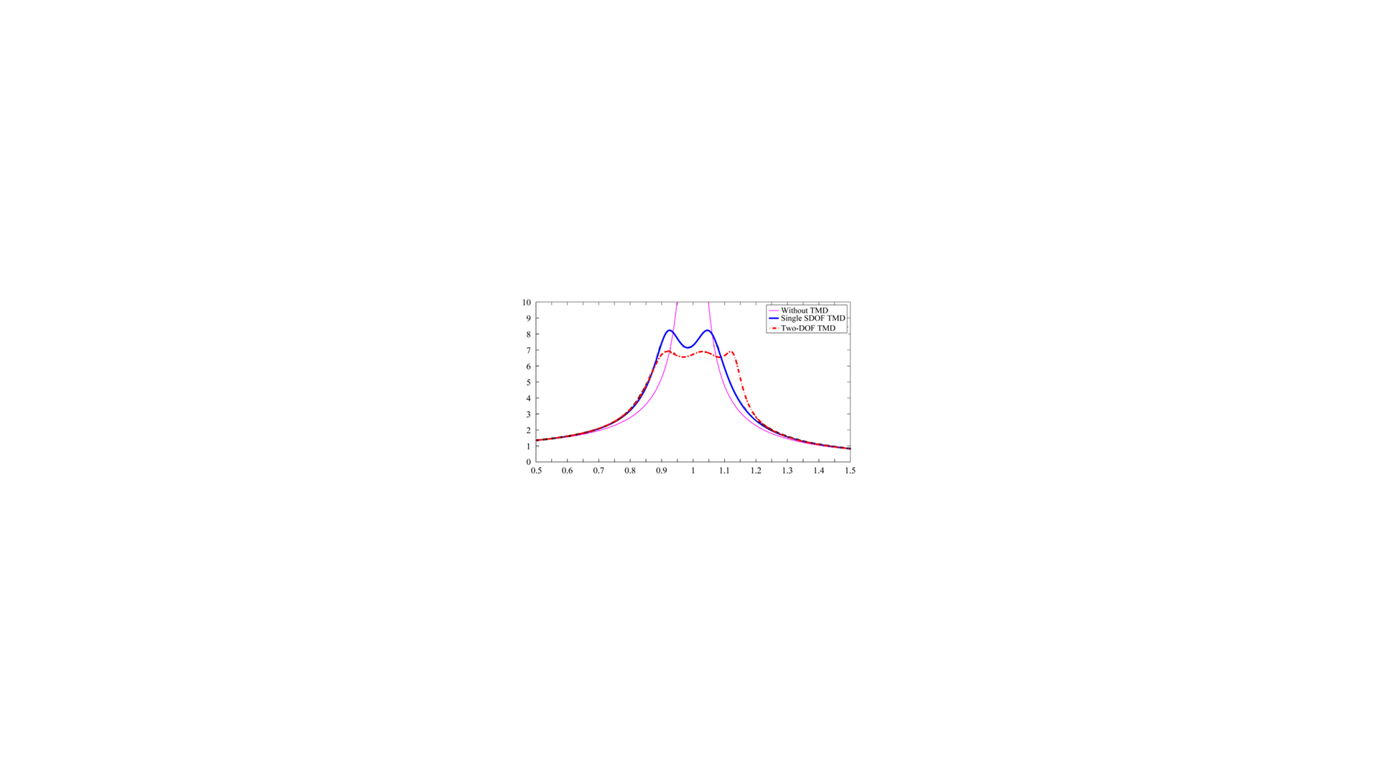
Without damping
With damping

Slide 16
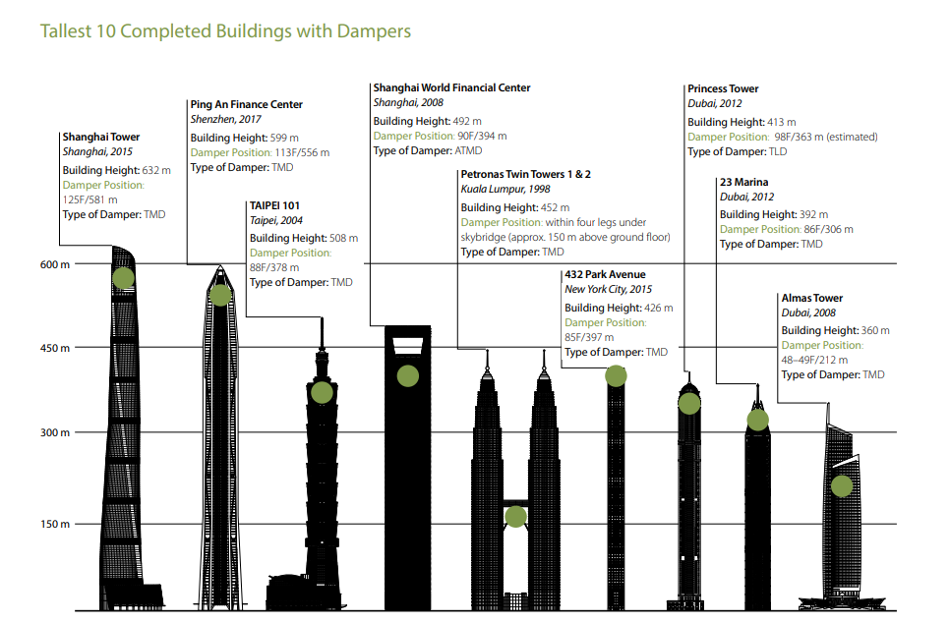

Slide 17
Literature review
Lei Zuo proposed the two-DOF TMD which yields better performance than two SDOF TMDs of equal mass .
Duncan and Rashid investigated the application of single-degree-of-freedom (SDOF) damper in milling. Moradi studied the optimum values of absorbers' position and springs' stiffness for various milling conditions such that the cutting tool vibration was minimized .
Saffury obtained analytically the frequency response function (FRF) of a non-uniform cantilever beam with multiple dampers by the functional perturbation method, and derived the optimized morphology of a general heterogeneous beam with single damper .
Sims proposed an analytical tuning criterion for the SDOF TMD in order to achieve the optimum chatter suppression.
Wang designed a nonlinear TMD equipped with an additional series friction-spring element, and proved that the critical cutting depth can be largely improved against the linear TMD.

Slide 18
conclusion
Dynamic vibration absorber without damper removes the original resonance peak in the response curve of the machine but introduces two new peaks. Thus the machine experiences large amplitudes as it passes through the first peak during start-upand stopping.
Most vibration absorbers used in practical applications are undamped. If damping is added, it defeats the purpose of the vibration absorber, which is to eliminate unwanted vibration. In a damped vibration absorber, the amplitude of vibration of the main mass will be nonzero.
Damping performances could be further improved by utilizing multiple DOFs of the TMD, i.e, increasing the number of TMDs or designing multi-DOF TMD.

Slide 19
Thank you

